Slide 1

Agents Negotiation
Noam Kazum · Omer Shani
Dr. Galit Haim · Dr. Raz Lin
Notes:
Good morning. This semester our project focused on the Automated Negotiating Agents Competition - ANAC 2026, which runs as part of IJCAI. We built two negotiation agents for two different leagues in the same competition, and each league posed a genuinely different research problem.

Slide 2

Agenda
1. Related Work
2. Competition Context
3. GunnerAgent Deep Dive
4. Agent360 Deep Dive
5. Comparative Analysis
6. Conclusion

Slide 3




Related Work
Theoretical Learning
Analyzing Past Winners
Running Tournaments
Conducting Experiments
Notes:
2026 brings us back to bilateral negotiation, but with a new scoring dimension: concealment. You're still rewarded for a good deal - Advantage - but also for how poorly your opponent learned your true preferences from your bids.
If opponents figure out what you care about, your concealment score drops even if the deal is fine. Agent360 was built for that tradeoff.

Slide 4
Two Agents, Two Challenges
Agent360 for ANL:
Capture a good deal
Hide preferences
Model opponents’ preferences
GunnerAgent for HAN:
Simulate human
Involving LLM - Natural language messages
Notes:
Our two submissions mirror the two leagues.
Agent360 targets concealment against learning opponents. GunnerAgent targets human-paced negotiation with a message every turn.
Same stack - different strategy. Agent360 first, then GunnerAgent, then compare at the end.

Slide 5

HAN 2026
Negotiation Pillar: Every move = offer + required free-text message to a human
Scoring Pillar:
Scored on utility and post-negotiation perception (questionnaires)
Offers Challenge:
~5 min ≈ ~10 offers per side - human-paced
Competition Flow:
LLM qualifying round → crowd-sourced humans → finalists
Notes:
What's new in 2026: every move must include a natural-language message. You're not just picking numbers - you're playing a character negotiating with a real person. Scored on deal utility and on how the human partner perceived the agent afterward.
The time budget is brutal compared to agent-vs-agent leagues - about ten propose calls per side. Every round counts. That rules out classical opponent modeling that assumes long bid histories. That's the constraint GunnerAgent was designed around.
Competition flow: first an LLM round against personality-adjusted simulators, then selected agents face crowd-sourced human subjects.

Slide 6
GunnerAgent: Pretending to be a Human
How to simulate a human by both Strategy and Communication
Negotiation flow
Real humans
AOP - Every turn you send an offer AND generate a short message
Evaluation:
Utility profit
Human survey
Challenges:
Only ~10 offers per side (5-minute clock).
Partner utility function is unknown
Human behavior
Notes:
Open Gunner section here. Key line: HAN is not harder math - it's math plus performance. Half the score is perception. Mention that ANL gives you opponent utility; HAN does not.

Slide 7
GunnerAgent: Two Layers (Core + LLM)
Layer 1 - GunnerCore
Decides everything about the deal
Modeling Opponent
Built on Shochan (ANAC 2024 winner)
Why split them?
So a language-model glitch can never cause a bad offer
Strategy stays deterministic and testable
Layer 2 - LLM wrapper (messages only)
the LLM writes 2-3 sentences the human reads
It never change the result
Notes:
This is the main design decision. Emphasize: numbers first, words second. Omer's split is what makes the agent safe to run against real humans.

Slide 8
Gunner Core
Based on Sochan (ANL 2024 Winner)
Short negotiation (10 steps each)
Opponent modeling
Minimum steps to agreement
Human simulation
Doesn't repeat the same offer more then 3 times
Two phase concession curve
Pareto frontier

Slide 9
LLM Layer
LLM Data
Scenario Response
Modular prompts
Injecting dynamic data:
Rules
Move brief
Partner last action
Offers history
Opponent behavior
Agent behavior
Current offer
Label agent action (opening, small concession…)
Label partner action (conceded, stuck, worsened…)
Tone fit to the scenario
Stability
Wide Control
Maintenance
Notes:
Close Gunner section. Persona is warm and assertive - never robotic, never apologetic. LLM sees partner messages and exact offer terms only. Utilities stay hidden.

Slide 10
ANL 2026
Negotiation Pillar: Bilateral agent vs agent
Concealing Pillar:
How poorly the opponent learned your true preferences from your bids
Hybrid Challenge:
Score = Advantage + Concealing
Strategic Impact:
Being modeled correctly hurts your score
Notes:
2026 brings us back to bilateral negotiation, but with a new scoring dimension: concealment. You're still rewarded for a good deal - Advantage - but also for how poorly your opponent learned your true preferences from your bids.
If opponents figure out what you care about, your concealment score drops even if the deal is fine. Agent360 was built for that tradeoff.

Slide 11
Agent360: Two Goals at Once
Strategy must balance both - not maximize either alone
Score = Advantage + Concealing, both count equally
Advantage:
Final deal utility minus your reservation value
Concealing: Opponent's learned model of you should stay wrong
Notes:
Let's zoom into Agent360. Remember the 2026 ANL rule from earlier: you're scored on two things at once.
Advantage is the familiar part - did you close a deal better than your walk-away value?
Concealing is what's new - after the negotiation, organizers check how well your opponent modeled your true preferences from your bids.
So Agent360 isn't a pure deal-maximizer. Every bid is both a negotiation move and a signal about your priorities.

Slide 12
Why is the Bid Stream the Battleground?
Research Question:
Which persona effectively conceals while sustaining high-utility?
Central Conflict:
Frequency learners are used by almost all competitors
Sincere Bidding Risks:
Truth mechanism wins in auctions, not in decoys
The Inference Trap:
Bidding top outcomes causes identification of true preferences
Notes:
Why does the scoring rule matter? Most league agents learn from your bid stream - frequent values look like high priorities.
Bid sincerely and Advantage may look fine, but the opponent's model converges quickly and Concealing collapses.
So we started with research: what should we show early to mislead learners without giving up the deal?

Slide 13
Three Decoy Personas
Gradient Persona - Gradual Mismatch:
Starting with a slightly skewed priority list with a slow transition
Full Flip Persona - Radical Approach: Presents entirely wrong priorities before an abrupt switch to its true preferences
Reverse Psychology Persona - Honest Approach:
sincere outcomes first but introduces tactical noise later to misdirect
Comparative Goal: Finding the 'Goldilocks' zone of deception
Notes:
We treated this as empirical research, not a guess. Three variants shared the same acceptance logic and opponent modeling - they differed only in what they show early.
Gradient: partially wrong priorities, gradual blend toward truth - hardest to detect, no sudden tell. Full flip: maximally wrong, then jump to a true band. Reverse: open with your actual best outcomes, then shift toward misdirection - the hypothesis that some opponents distrust bids.
We benchmarked all three across competition scenarios, both seats, against learner and deceptive opponents.

Slide 14
Gradient Persona Won
False priority profile while keeping utility high enough
Full Flip Rejected:
Abrupt changes are easily detected
Reverse Psychology Rejected:
Concealment collapsed
Notes:
Reverse looked good in some matchups but failed against the learner agents that dominate the field. Full flip didn't beat the middle ground reliably.
The winner: a sustained false early signal with gradual revelation when deal extraction matters more. That's the core of Agent360.

Slide 15
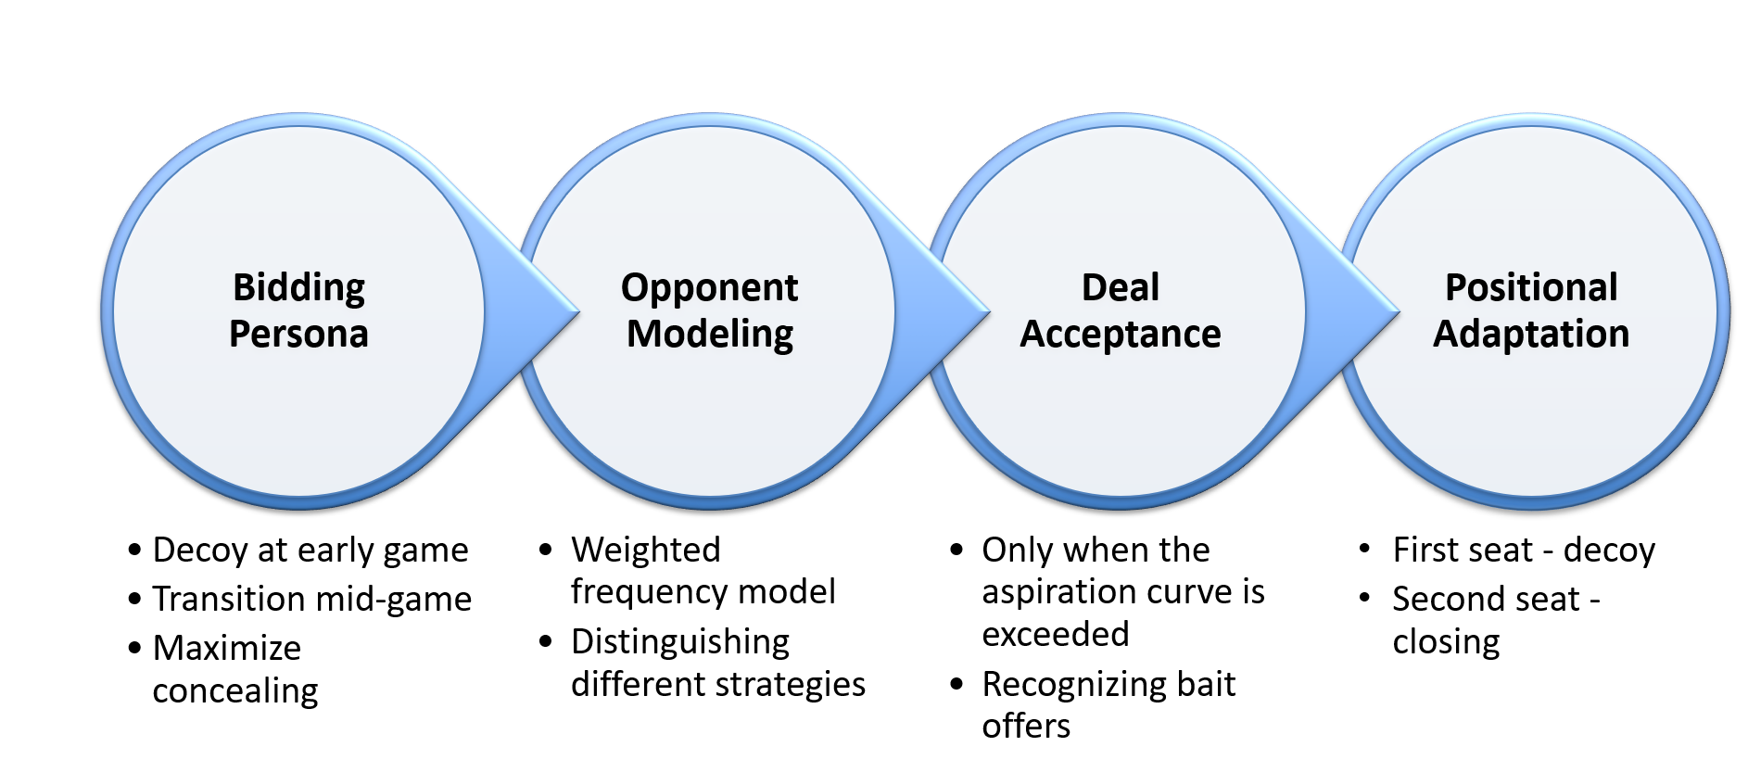
Negotiation Flow
Notes:
Three separate layers - so improving deal extraction never accidentally breaks the decoy persona.
On each step: partner offer → update model → accept? → else bid from current phase.

Slide 16
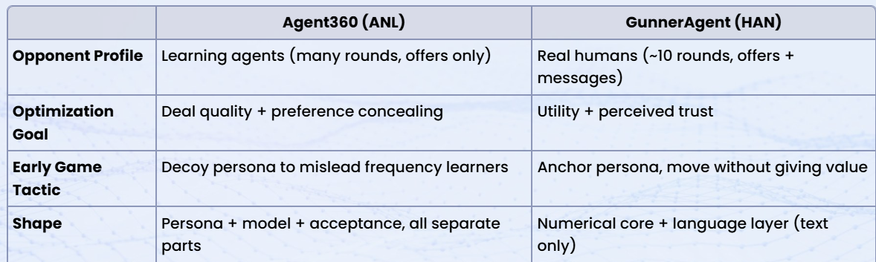
Same Stack, Opposite Strategies
Notes:
You've now seen both agents. Same NegMAS foundation - opposite choices wherever the leagues differ.
Agent360 misleads learners with a decoy persona; GunnerAgent anchors early and sounds human while the numerical core holds firm. Both inherited from Shochan and only kept changes that helped across opponent types.
One thesis: match strategy to the scoring rule and the data budget.

Slide 17





Lessons & Conclusions
Rules of the Game:
Strategy must be adopted according to the scoring method
Data Budget Realism: Opponent modeling must be tailored according to resources
Diversity in Testing: Evaluate agents across different scenarios
Modular Separation: Separate layers for independent experiments
Empirical Iteration: Trust results over intuition and theory
Notes:
Five lessons. The scoring rule defines the strategy. Modeling must fit the data budget. No single benchmark tells the whole story. Separate what fails independently - persona from acceptance, numbers from language. Research, benchmark, keep or rollback.
Thank you. Happy to take questions.

Slide 18
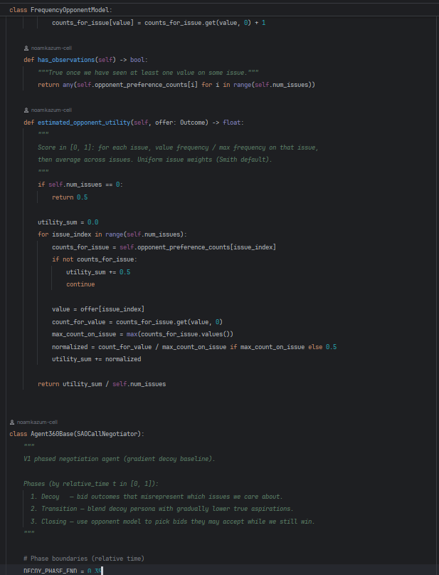
Thank You For Listening!

